Slide 1
Extended Drude Model of
Resistivity, Shot Noise and
Johnson Noise
Christoph Harder
2023 05 02 , rev. 2024 04 02

Slide 2
Content
Noise in electrical systems
  Non-equilibrium (Shot noise) and equilibrium (Johnson noise)
Shot Noise and Johnson noise
Drude model for resistivity
Shot noise
Extended Drude model for Johnson noise
More statistical mechanics
Thermodynamic model of Johnson noise
Discussion
Appendix
  Rigorous derivation (Amon Yariv)
  Ideal gas and kinetic energy of particles
Notes:
It is very complex to model from first principles the transport of electrical energy in solid state, i.e. current as function of applied voltage.
Often used is the so called Drude model which based on electrons being scattered and by introducing internal parameters, such as mass of the electronic charge, scatter time (i.e. free path length) and number of free electrons. These parameters are either calculated based on assuming that the electron behaves like a wave in the solid state and/or fitted to the measurements of the external parameters, current and voltage.
This Drude model gives some insights but has also its limits, most notably predicting wrong temperature dependence of resistance.
In this presentation we extend the Drude model to not only model resistivity but also Johnson noise in resistors.

Slide 3
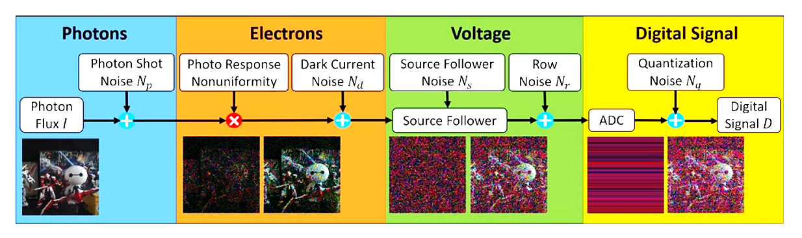
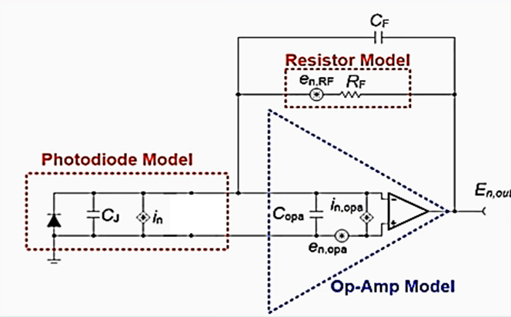
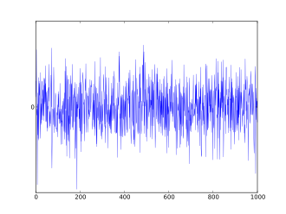
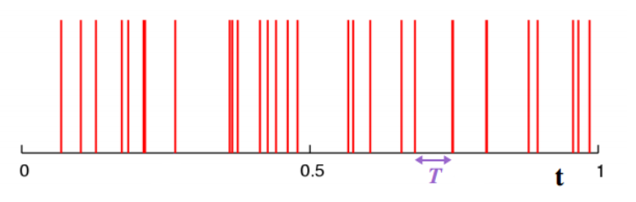
Fundamental limits to signal quality: Noise
Shot noise
Thermal noise
Non-equilibrium devices:
Photodiodes, Laserdiodes,
Equilibrium devices:
Resistors
Notes:
Shot noise: Light propagation is treated as wave and light detection as arrival of particles leading to shot noise, simplifying the exact quantum-mechanical description of the particle wave nature of light. Electrons are also treated as waves for propagation but can be detected individually only as particles.
Thermal noise: Thermal fluctuations manifest themselves in electronic circuits as noise.
Digital noise: The process digitizing and analog signal leads to digitization noise. We do not address this digital noise

Slide 4
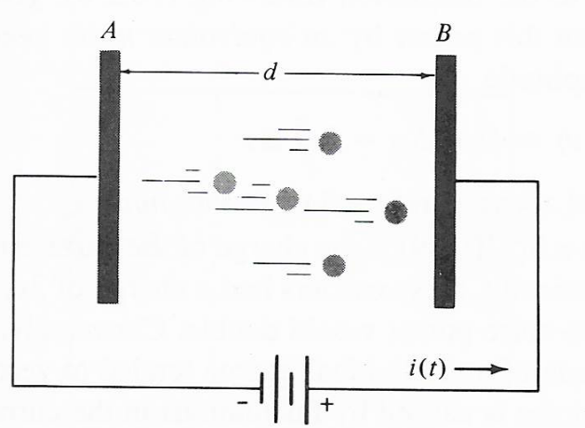
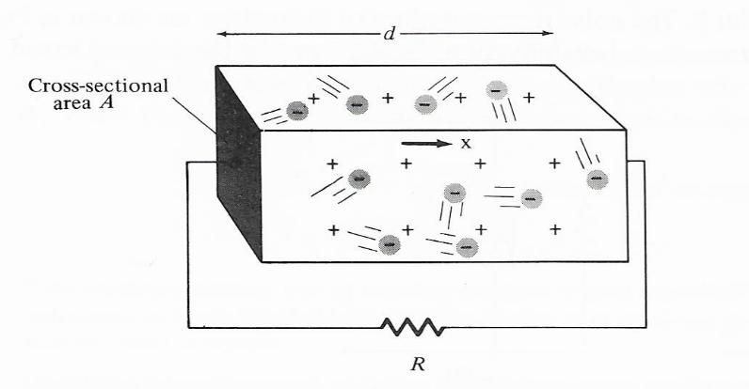
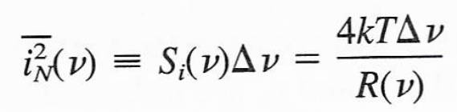
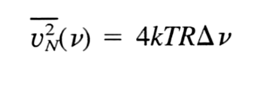

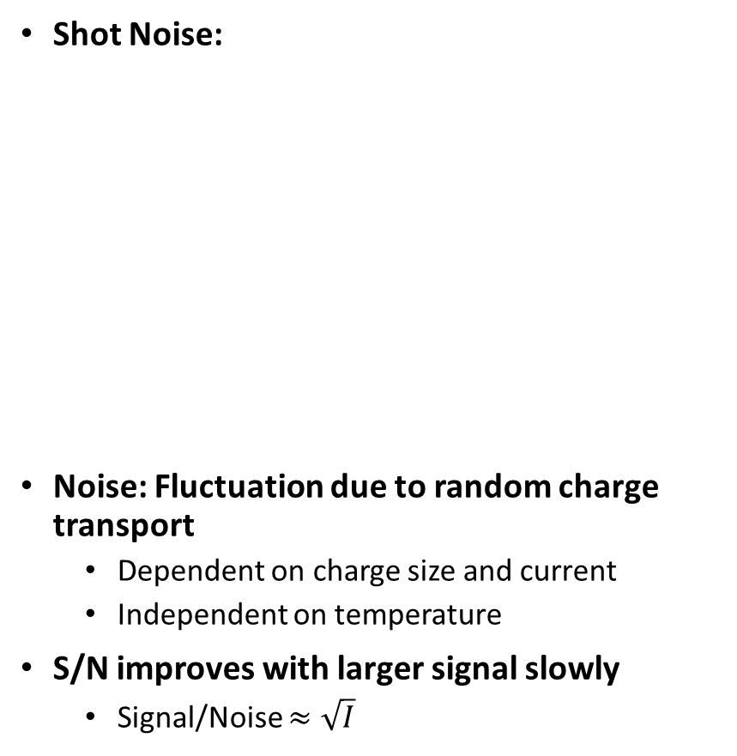
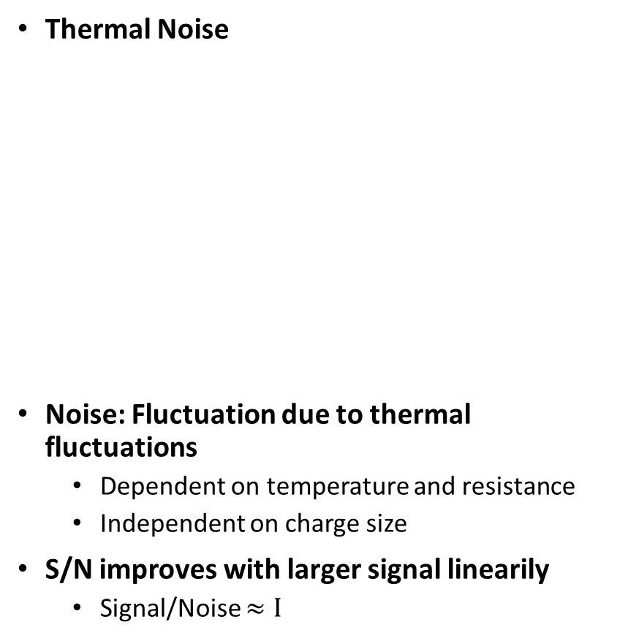
Shot Noise and Johnson Noise
Shot Noise:
Noise: Fluctuation due to random charge transport
  Dependent on charge size and current
  Independent on temperature
S/N improves with larger signal slowly
  Signal/Noise $≈\sqrt{I}$
Thermal Noise
Noise: Fluctuation due to thermal fluctuations
  Dependent on temperature and resistance
  Independent on charge size
S/N improves with larger signal linearily
  Signal/Noise $≈I$
Notes:
Shot noise and Johnson noise seem to have different origins.
Deep statistical mechanics, including quantization, can make the connection (and Plank derived his formula from the 2nd law of thermodynamics, including quantization).
A simple extended Drude model will be used in this presentation to make a connection between shot noise and Johnson noise.

Slide 5
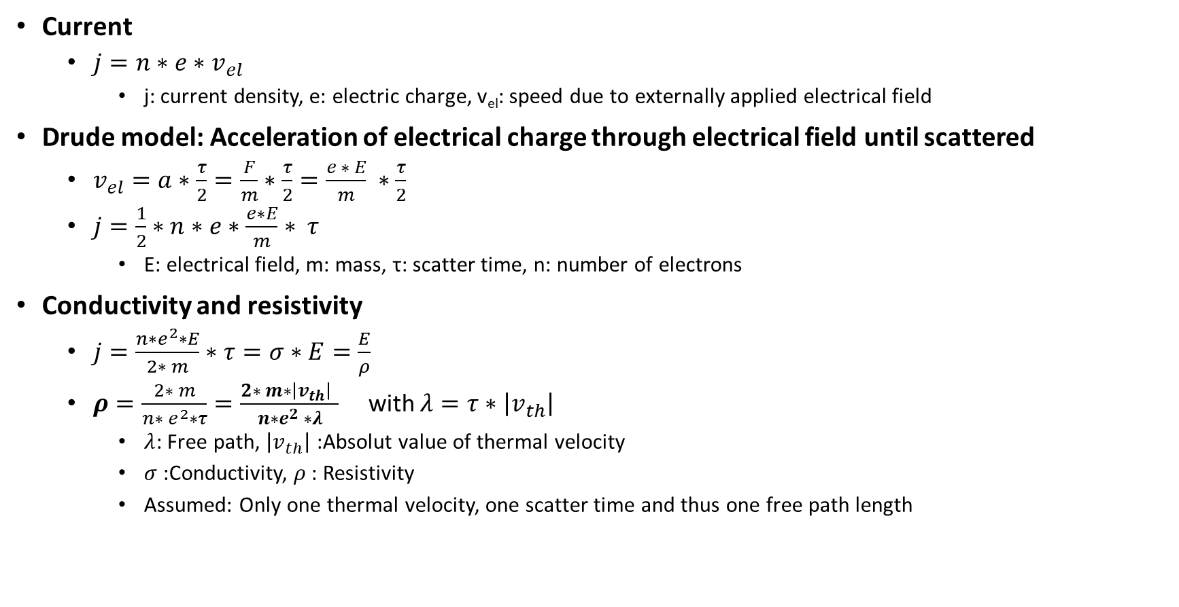
Drude-Model for resistivity
Current
  $j=n∗e∗v_{el}$
    j: current density, e: electric charge, v_{el}: speed due to externally applied electrical field
Drude model: Acceleration of electrical charge through electrical field until scattered
  $v_{el}=a∗\frac{τ}{2}=\frac{F}{m}∗\frac{τ}{2}=\frac{e ∗ E}{m} ∗\frac{τ}{2}$
  $j=\frac{1}{2}∗n∗e∗\frac{e∗E}{m}∗ τ$
    E: electrical field, m: mass, τ: scatter time, n: number of electrons
Conductivity and resistivity
  $j=\frac{n∗e^{2}∗E}{2∗ m}∗τ=σ∗E=\frac{E}{ρ}$
  $ρ=\frac{2∗ m}{n∗ e^{2}∗τ}=\frac{2∗ m∗\left|v_{th}\right| }{n∗e^{2} ∗λ}$ with $λ=τ∗\left|v_{th}\right|$
    $λ$: Free path, $\left|v_{th}\right|$ :Absolut value of thermal velocity
    $σ$:Conductivity, $ρ$ : Resistivity
    Assumed: Only one thermal velocity, one scatter time and thus one free path length
Notes:
The Drude model gets some insight into resistivity., baed on extremely simplified statistical mechanics
However, it is well known that the Drude model leads to a wrong temperature dependence of the resistivity, i.e. with square root dependence on temperature while the observation yields a linear dependence. This can be corrected if we introduce a scatter time is inversely proportional to temperature:
For T dependence: $ρ=\frac{2∗ m∗T}{n∗ e^{2}∗τ\left(T_{0}\right)∗T_{0} }=\frac{2∗ m∗\left|v_{th}\right| }{n∗e^{2} ∗λ(T)}=\frac{2∗ m∗{\left|v_{th}\right|}^{3} }{n∗e^{2} ∗λ\left(T_{0}\right)∗{\left|v_{0}\right|}^{2}}$ as $τ\left(T\right)=τ\left(T_{0}\right)∗{T_{0}}/T$

Slide 6
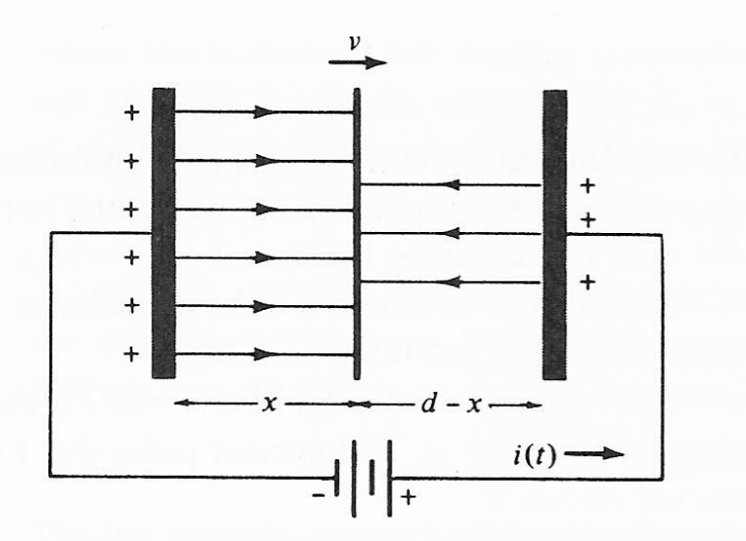
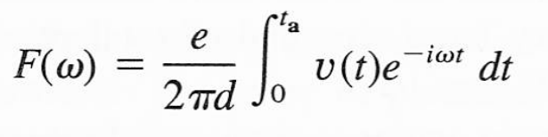

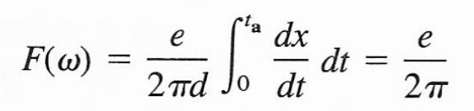
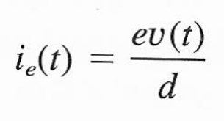
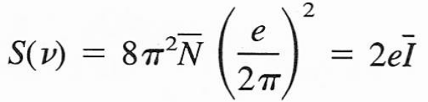

Shot Noise: Non-equilibrium
Speed of electrical charge and current
Time domanin
Fluctuations (Frequency domain)
  Fourier transform of single pulse
  For
  From Fourier (with Carlson’s theorem) to spectral density
  Shot noise due to fluctuations
  $$\overline{i_{N}^{2}}=2⋅ⅇ⋅\overline{I}⋅Δv$$
Notes:
One could think of shot noise as the single scatter event in the Drude model. Statistical analysis then relates the fluctuation (noise) with the transport (current).
Shot noise is well known to electrical engineers in
Photodetectors
Diodes. At 0 voltage there is no net current flowing in the diode, as opposite electron and hole current compensate each other with resulting noise fluctuation corresponding to the sum of the elctron current noise and hole current noise (as not correlated)

Slide 7
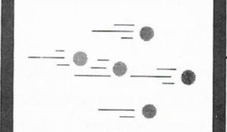
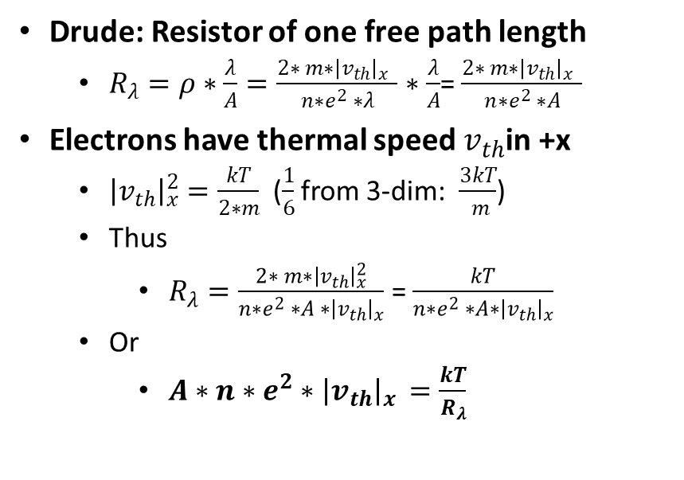


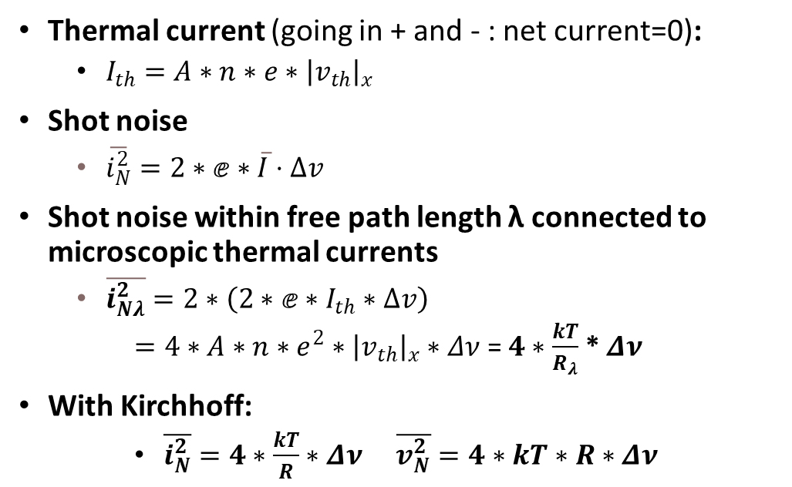
Extended Drude model of Johnson noise
$$λ$$
R
$$R_{λ}$$
I_{th}
I_{th}
Drude: Resistor of one free path length
  $R_{λ}=ρ∗\frac{λ}{Α}=\frac{2∗ m∗{\left|v_{th}\right|}_{x} }{n∗e^{2} ∗λ}$ $∗\frac{λ}{Α}$= $\frac{2∗ m∗{\left|v_{th}\right|}_{x} }{n∗e^{2} ∗A}$
Electrons have thermal speed $v_{th}$in +x
  ${\left|v_{th}\right|}_{x}^{2}=\frac{kT}{2∗m}$ ($\frac{1}{6}$ from 3-dim: $\frac{3kT}{ m}$)
  Thus
    $R_{λ}=\frac{2∗ m∗{\left|v_{th}\right|}_{x}^{2}}{n∗e^{2} ∗A ∗{\left|v_{th}\right|}_{x}}$ = $\frac{kT}{n∗e^{2} ∗A∗{\left|v_{th}\right|}_{x}}$
  Or
    $A∗n∗e^{2}∗{\left|v_{th}\right|}_{x }=\frac{kT}{R_{λ}}$
Thermal current (going in + and - : net current=0):
  $I_{th}=A∗n∗e∗{\left|v_{th}\right|}_{x}$
Shot noise
  $\overline{i_{N}^{2}}=2∗ⅇ∗\overline{I}⋅Δv$
Shot noise within free path length λ connected to microscopic thermal currents
  $\overline{i_{Nλ}^{2}}=2∗\left(2∗ⅇ∗I_{th}∗Δv\right)$
    $=4∗A∗n∗e^{2}∗{\left|v_{th}\right|}_{x}∗Δν$ = $4∗\frac{kT}{R_{λ}}$ * $Δν$
With Kirchhoff:
    $\overline{i_{N}^{2}}=4∗\frac{kT}{R}∗Δν$ $\overline{v_{N}^{2}}=4∗kT∗R∗Δν$
Notes:
This simple model is based on
Assumption
Resistor can be subdivided in free path length
For voltage at electrodes along x direction only movement of electrons in x directions are of importance with electron velocity (energy) derived from ideal gas eauation (see appendix)
And as in diodes
Opposite thermal electron currents cancel each other in thermal equilibrium (no net current)
Noise of opposite electron currents add (no correlation)
Exact statistical derivation: See appendix

Slide 8
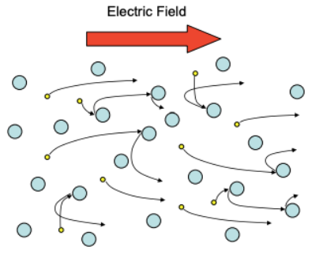
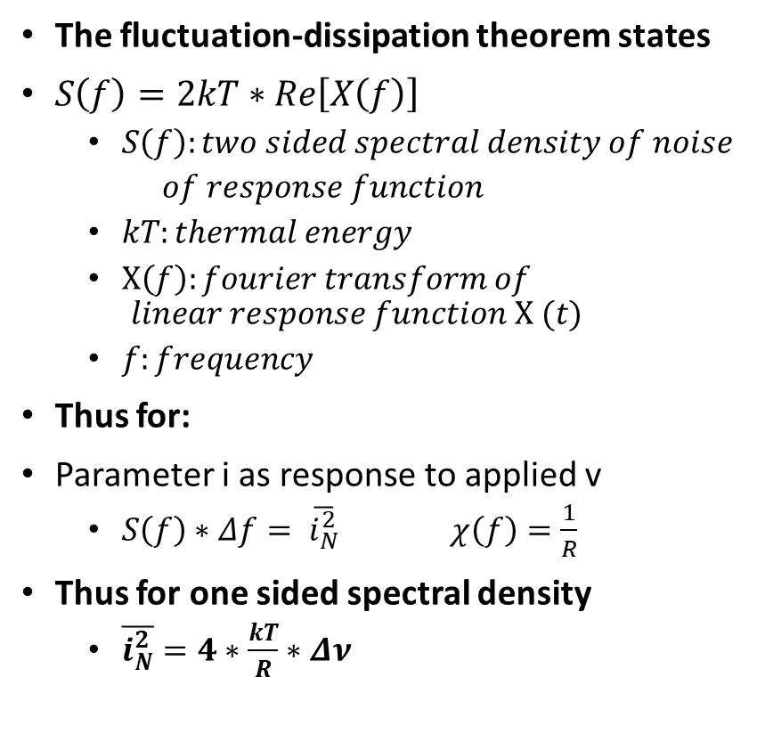
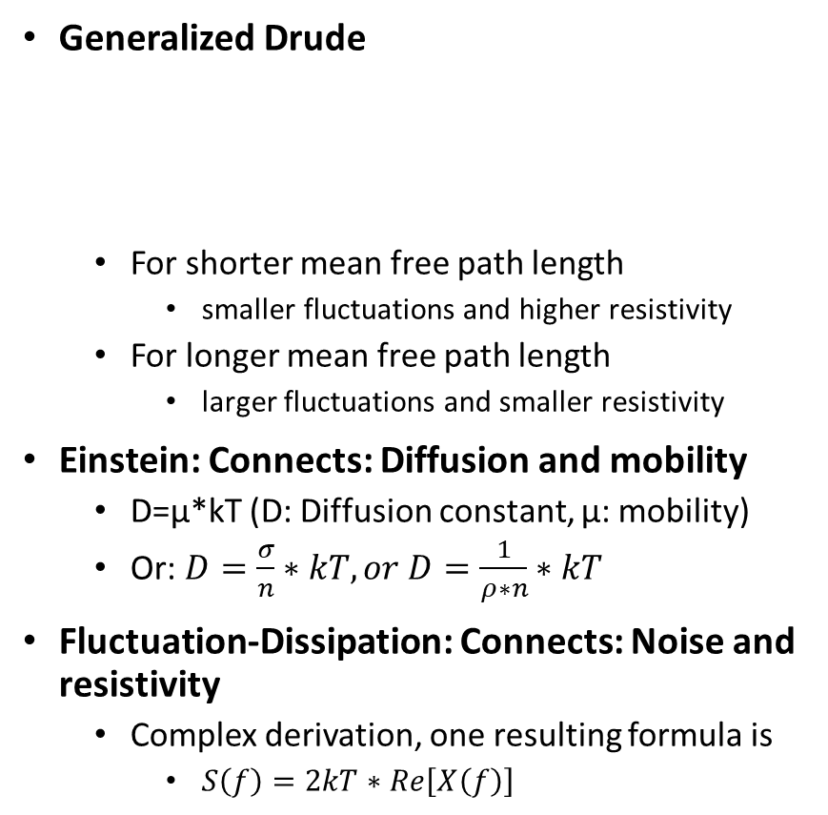
More statistics based on particle model
Generalized Drude
  For shorter mean free path length
    smaller fluctuations and higher resistivity
  For longer mean free path length
    larger fluctuations and smaller resistivity
Einstein: Connects: Diffusion and mobility
  D=μ*kT (D: Diffusion constant, μ: mobility)
  Or: $D=\frac{σ}{n}∗kT, or D=\frac{1}{ρ∗n}∗kT$
Fluctuation-Dissipation: Connects: Noise and resistivity
  Complex derivation, one resulting formula is
    $S\left(f\right)=2kT∗Re\left[Χ\left(f\right)\right]$
The fluctuation-dissipation theorem states
$S\left(f\right)=2kT∗Re\left[Χ\left(f\right)\right]$
  $S\left(f\right):two sided spectral density of noise$
  $of response function$
  $kT:thermal energy$
  $Χ\left(f\right):fourier transform of$
  $$linear response function Χ (t)$$
  $f:frequency$
Thus for:
Parameter i as response to applied v
  $S\left(f\right)∗Δf= \overline{i_{N}^{2}} χ\left(f\right)=\frac{1}{R}$
Thus for one sided spectral density
  $\overline{i_{N}^{2}}=4∗\frac{kT}{R}∗Δν$
Notes:
Drude analysis the resistivity based on particles being scattered
Based on this particle model more extensive statistical analysis leads to
Relation between mobility and diffusion as stated in well known Einstein relation
Noise (fluctuations) and resistance (dissipation) as in stated in well known fluctuation dissipation therorem.
The fluctuation-dissipation theorem states that a “viscous” material will have smaller fluctuations as well as a smaller response to an external perturbation than a “liquid” material.
In our case it connects the fluctuations of the current in the resistor with the response of the current to the external perturbation (voltage). Thus, it is obvious, that a large resistor (thus small current change if voltage is applied) will have smaller current fluctuations (which of course increase with thermal energy kT). Factor 4 is obtained from exact math.
Thus $\overline{i_{N}^{2}}=4∗\frac{kT}{R}∗Δν$
This approach is elegant as it is based on extensive statistical mechanics and is elegant as its final formula includes only externally measured entities (I, T, R) and it makes no assumption whatsoever about the internal mechanism of the resistor, no assumption about the surroundings, but it is obviously limited to thermal equilibrium.

Slide 9
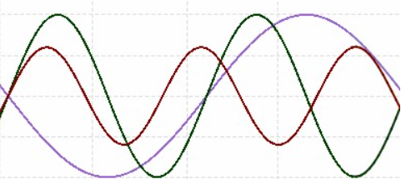
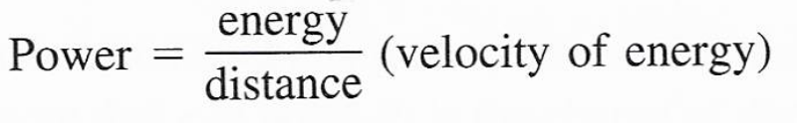
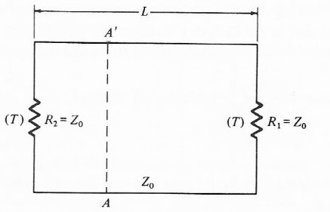
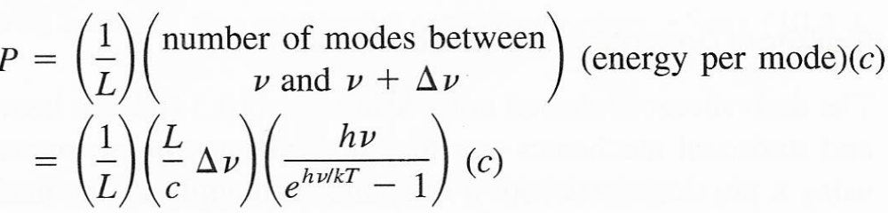

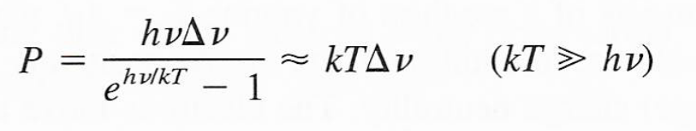
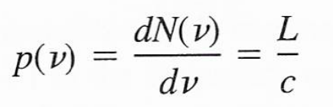

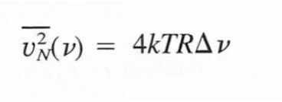
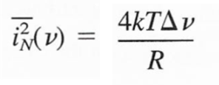
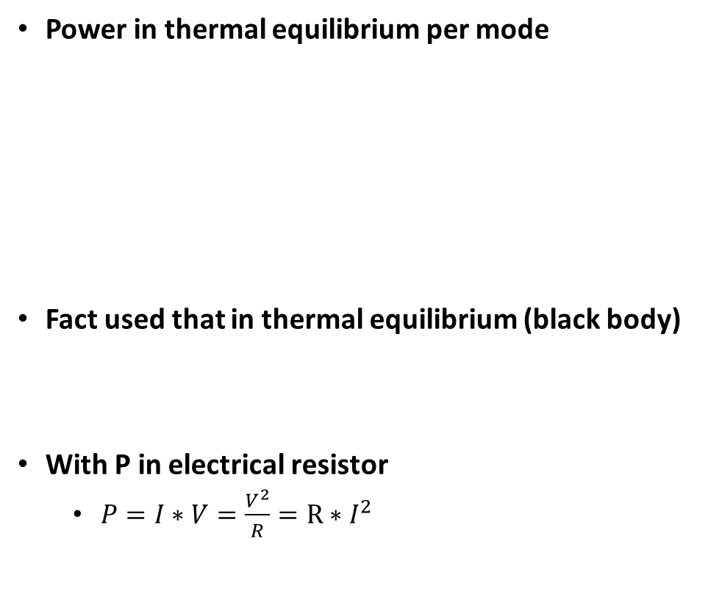
Thermodynamic derivation of Johnson Noise
Transmission line (Z₀) between R₁ and R₂
Modes on transmission line (standing wave)
    v: voltage, ώ: frequency, k: wavevector, L: length
Number of modes per unit frequency
    p(ν): number of modes per unit frequency
Power in thermal equilibrium per mode
Fact used that in thermal equilibrium (black body)
With P in electrical resistor
  $P=I∗V=\frac{V^{2}}{R}=R∗I^{2}$
T
Z₀
R=Z₀
R=Z₀
Z₀
Notes:
Johnson noise is usually derived from the observation of Planck of the black body radiation.
A link between black body radiation and (quantized) statistical analysis is nicely described in the literature, i.e. “The second Law” by Stephen Wolfram.
This approach is elegant as it is based on externally measured entities (I, T, R) and it makes no assumption whatsoever about the internal mechanism of the resistor. However, it assumes that the surrounding is in equilibrium with the resistor (same temperature T) and is thus strictly only valid if the resistor has the same temperature as the surroundings.

Slide 10
Discussion:
Particle model derivation of resistivity, shot noise and Johnson noise:
  Drude model: Simplified model of n particles of mass m and free path length λ (scatter time τ)
    Basic entities such as number of particles, their mass as well as the free path length cannot be measured and are either calculated by treating electrons as a wave in the material or determined to fit the measurable entities such as I, R or even noise.
    Resistivity
      The standard Drude model is used to model resulting current for an applied voltage in thermodynamic equilibrium
    Shot noise
      Analyzing current flow based on single events leads to a relation between fluctuations for current flow
    Johnson noise
      Johnson noise is derived based on a combination of shot noise and the drude resistivity model, as an example of an extremely simplied statistical mechanical model
  Deep statistical mechanics leads to
    Einstein: Relation between diffusion due to thermal forces and movement due to an external force
    Fluctuation-dissipation theorem: Relation between random movement (Noise) and resistance to external force
    Black body radiation: By adding quantum to statistical mechanics Planck derived the famous black body radiation formula
  Relation between resistance to externally applied disturbance (dissipation) and resistance to thermal fluctuations: Fluctuation-dissipation theorem
    Most elegant method as it makes no assumptions about inner structure or environment and it relates from first principles the measured entities I, R and T
  Drude model gives useful insight into resistivity and also Johnson noise (both in equilibrium) as well as shot noise (non-equilibrium)
  Drude model based on many assumptions on detailed inner works, fitted to match observations and fails to predict temperature dependence of resistivity etc.
Alternative models to calculate Johnson noise
  Equilibrium of resistance with black body energy of environment
    Mostly used in textbooks. Elegant as it makes no assumptions about inner structure or environment but assumes equilibrium with environment. It relates from first principles the measured entities I, R and T.
Notes:
Modelling of reality
Microscopic (statistical mechanics) and collective (thermodynamic) model should give the same results and they should only differ in the complexity to explain reality. Usually, complexity of the model can be reduced by limiting its range of application or extended by increasing complexity. Thus, Planck derived black-body radiation based on the 2nd law of thermodynamics which is connected statistical mechanics by adding quantization.
Drude Model
The Drude model makes a lot of assumptions about the inner works of the resistor, it treats current as movement of particles with charges (and thus must make assumptions/calculations about the mass (often derived by assuming that the charge behaves like a wave in a solid state material), charge, scatter time and thermal energy). By careful choice of parameters results for resistivity can be obtained for the thermal equilibrium case.
Shot noise
Shot noise can be considered as a special case of the Drude model where individual particles are tracked between two scatter events and it gives insight into non-equilibrium cases.
Extended Drude Model
The Drude model can be easily extended to model Johnson noise
Deep statistical mechanics
Based on deep statistical mechanics of particles moving randomly two important relations between collective characteristics of particles can be derived, i.e. the Einstein relation between mobility and diffusion and the relation between noise and resistance (usually called fluctuation-dissipation theorem).
Of course, this analysis is usually only done for low frequencies, but, if quantum is included in statistical mechanics its validity is extended across the whole spectrum and results in the black-body radiation formula (Planck started from the second law).
Blackbody derivation of Johnson noise
This derivation of Johnson noise is mostly used in textbooks and is based on putting the resistor in equilibrium with the surrounding, whose thermal noise we do know (black body radiation).
This approach is elegant as it is based on externally measured entities (I, T, R) and it makes no assumption whatsoever about the internal mechanism of the resistor. However, it assumes that the surrounding is in equilibrium with the resistor (same temperature T).

Slide 11
Appendix
Rigorous derivation (Amon Yariv)
Ideal gas and kinetic energy of particles

Slide 12
Rigorous derivation
Optical Electronics in Communication Systems, ISBN 0-19-510626-1, PP. 359-372, by Amnon Yariv

Slide 13
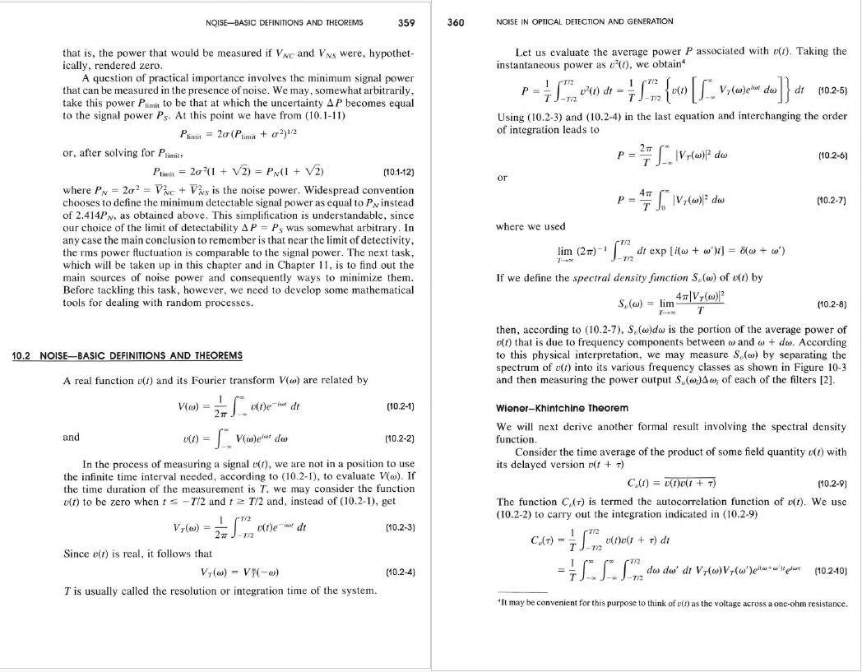

Slide 14
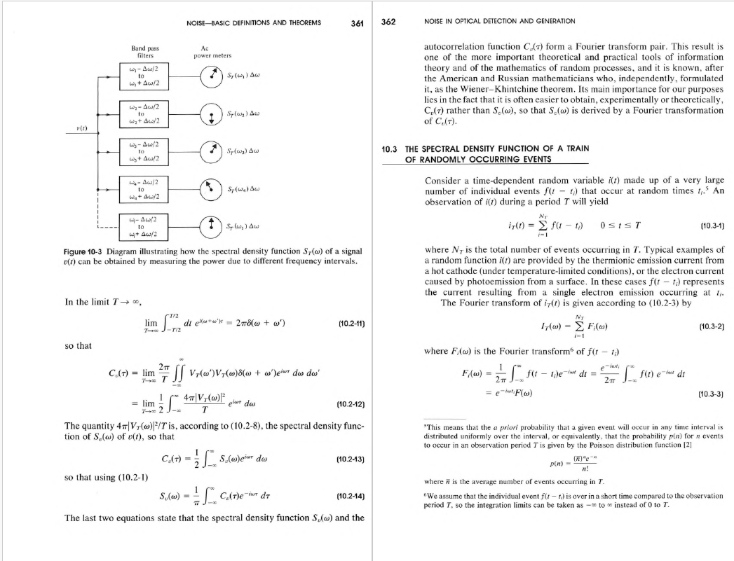

Slide 15
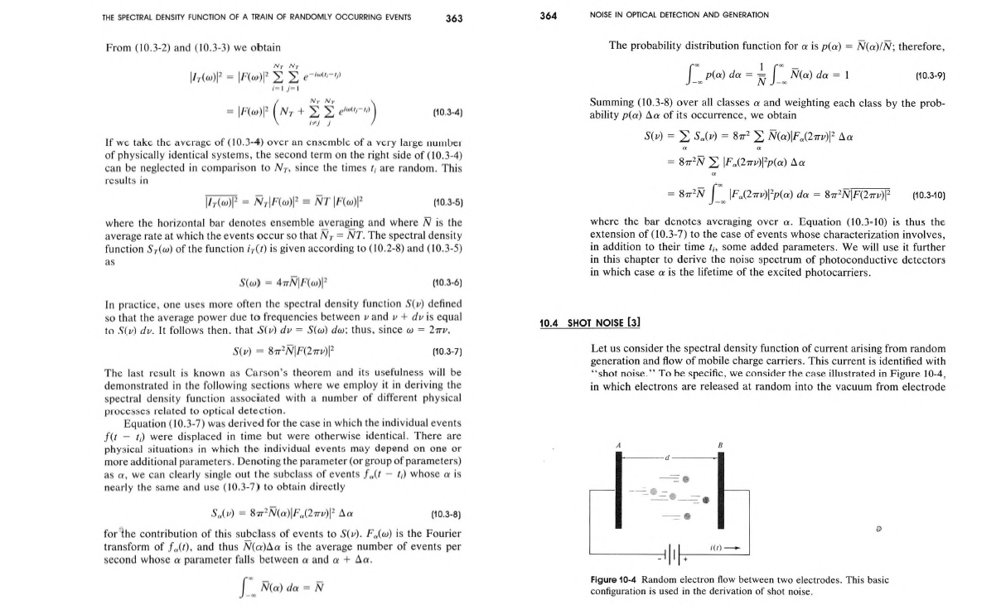

Slide 16
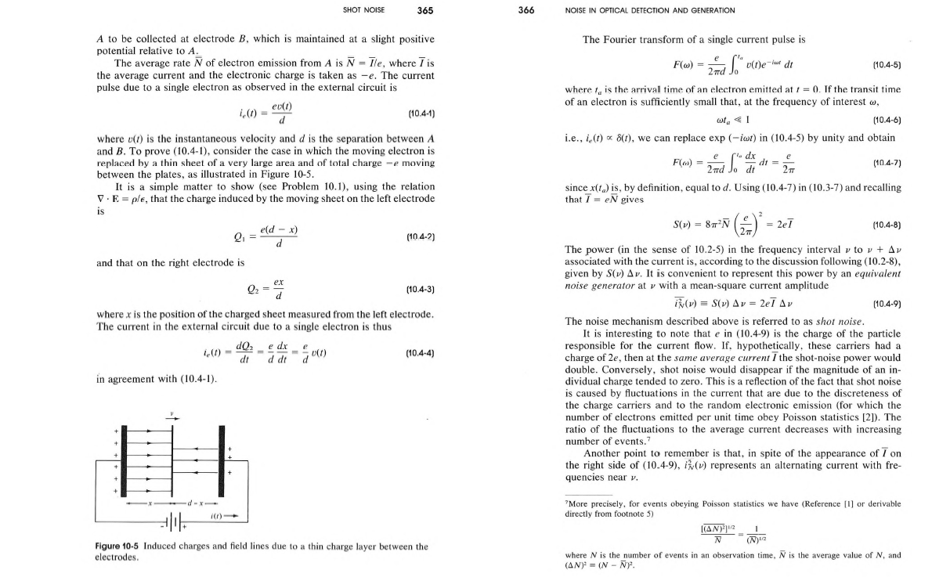

Slide 17
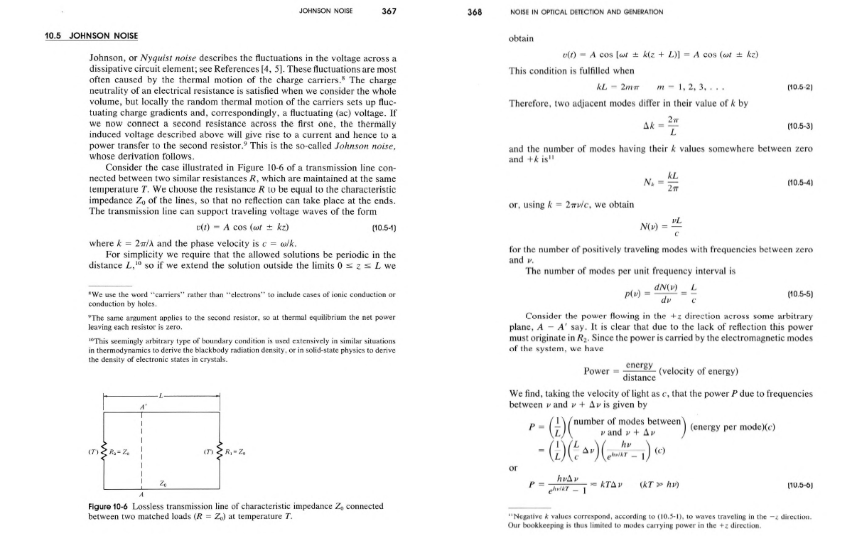

Slide 18
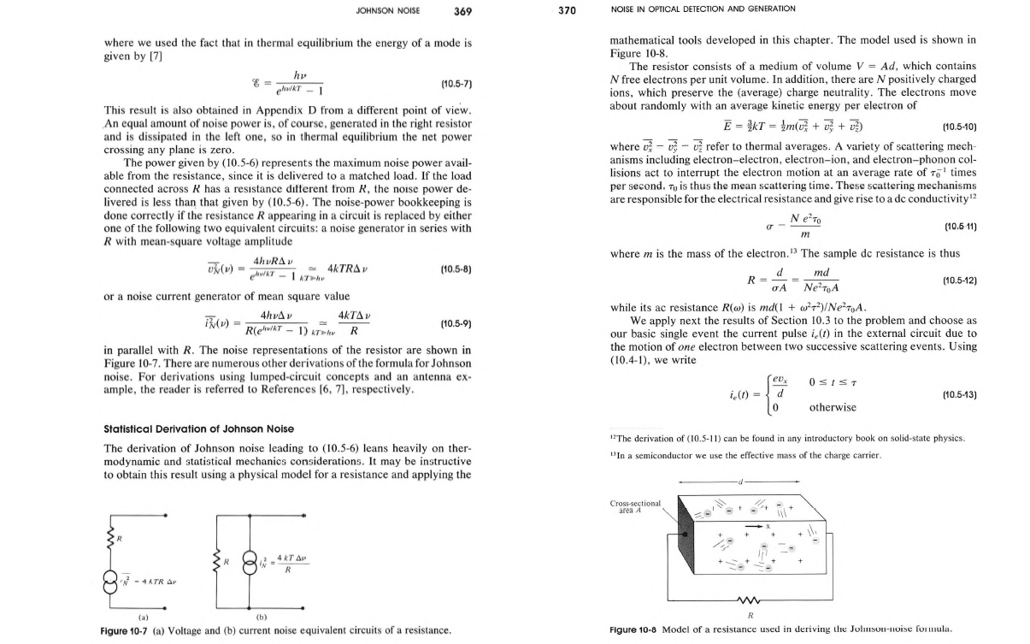

Slide 19
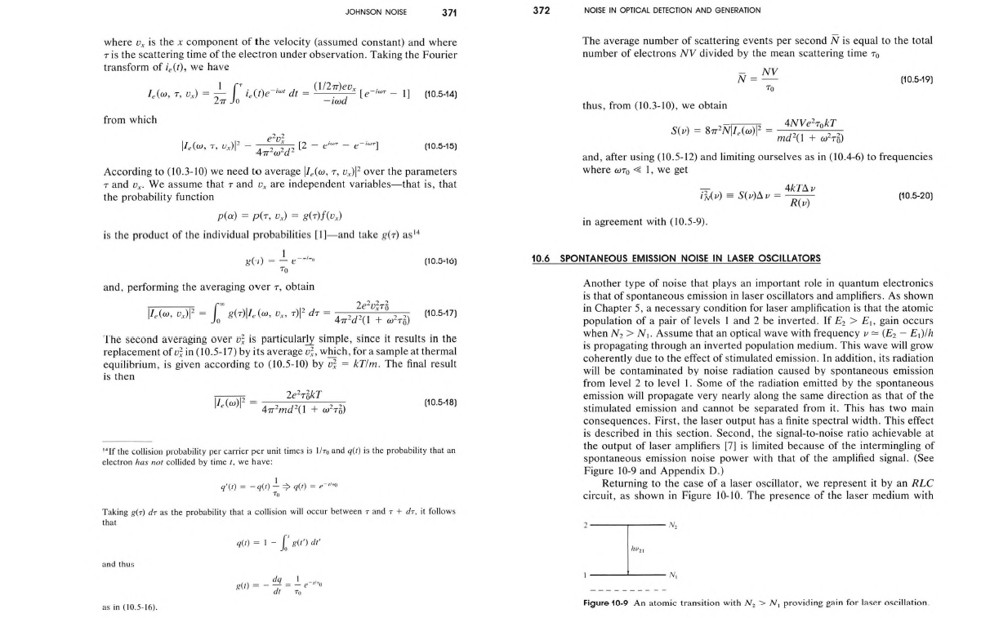

Slide 20
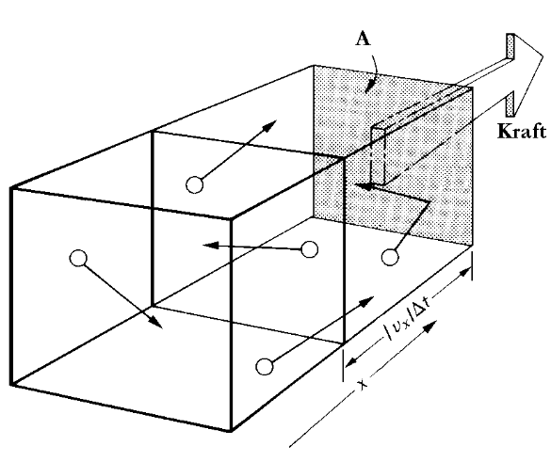
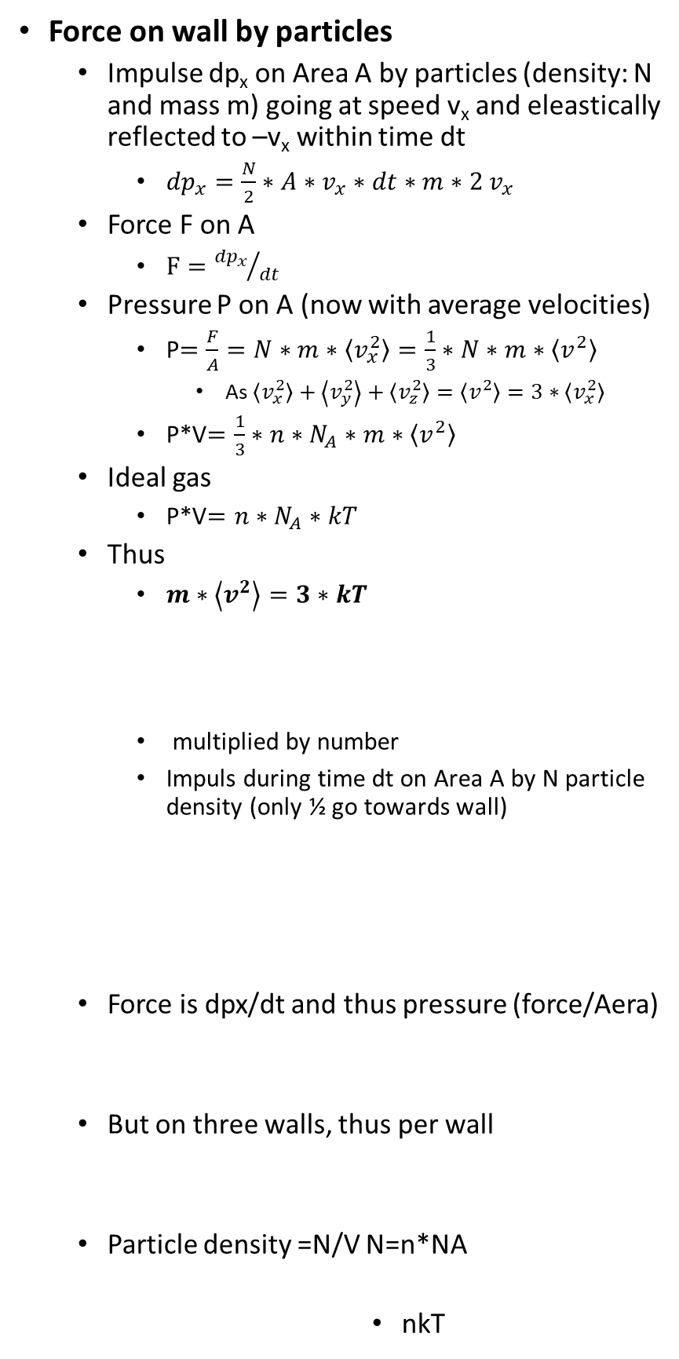
Ideal gas and kinetic energy of particles
Force on wall by particles
  Impulse dp_{x} on Area A by particles (density: N and mass m) going at speed v_{x} and eleastically reflected to –v_{x} within time dt
    ${dp}_{x}=\frac{N}{2}∗A∗v_{x}∗dt∗m∗2 v_{x}$
  Force F on A
    $F={{dp}_{x}}/{dt}$
  Pressure P on A (now with average velocities)
    P$=\frac{F}{A}=N∗m∗\left\langle v_{x}^{2}\right\rangle =\frac{1}{3}∗N∗m∗\left\langle v^{2}\right\rangle$
      As $\left\langle v_{x}^{2}\right\rangle +\left\langle v_{y}^{2}\right\rangle +\left\langle v_{z}^{2}\right\rangle =\left\langle v^{2}\right\rangle =3∗\left\langle v_{x}^{2}\right\rangle$
    P*V$=\frac{1}{3}∗n∗N_{A}∗m∗\left\langle v^{2}\right\rangle$
  Ideal gas
    P*V$=n∗N_{A}∗kT$
  Thus
    $m∗\left\langle v^{2}\right\rangle =3∗kT$
    multiplied by number
    Impuls during time dt on Area A by N particle density (only ½ go towards wall)
  Force is dpx/dt and thus pressure (force/Aera)
  But on three walls, thus per wall
  Particle density =N/V N=n*NA
            nkT

