Slide 1
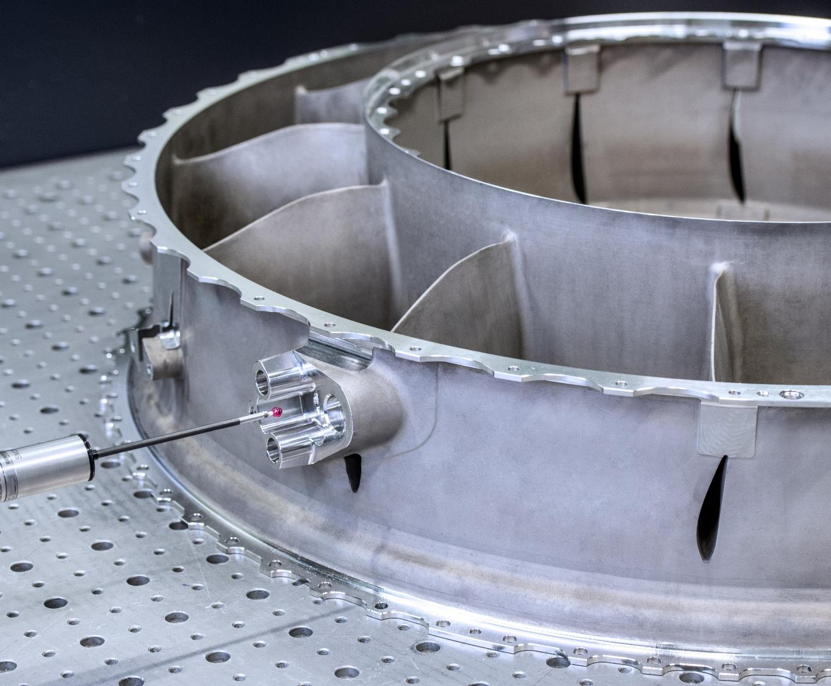

FRANKE INDUSTRIE AG
High-end components for aerospace and energy sector
when performance matters frankeindustries.com

Slide 2
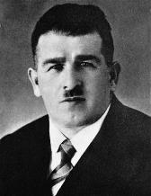
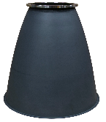
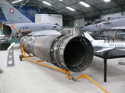
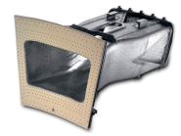
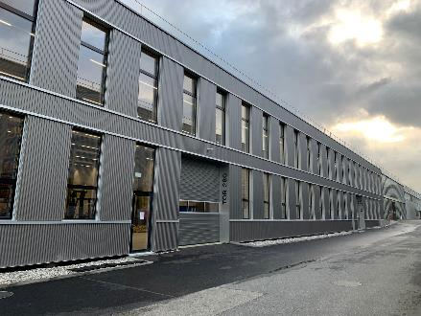


FRANKE INDUSTRIE AG HISTORY
1911
Founder
Hermann Franke founds a metal factory in Rorschach/ Switzerland
and moved the premises 1939 to Aarburg. After availability of stainless steel, the production of sinks was launched.
1950
First step in Aerospace
ATAR Hot-Section Part / Afterburner
Franke was selected from the Swiss Government
to produce the parts
within the procure-
ment of the new fighter aircraft for Switzerland.
1975
First step in Gasturbines
Franke has been manufacturing the core hot gas parts for various OEMs gas turbine concepts.
1980
Rocket Engines
Franke was evaluated to be part of the engineering group for the Aestus-engine (second stage of Ariane 5)
Franke was selected by several OEMs to produce components in the hot section of aircraft engines.
2004
Conversion
Franke Industrie AG was converted into an independent stock corporation. Today, the company focuses on the fabrication of Hot Gas Path Parts.
2018
Acquisition
Franke Industrie AG acquires a German high precision machining Company and expands in the aerospace segment.
2022
Acquisition
Franke Industrie AG acquires the Swiss Production site VERWO Spreitenbach.
This acquisition extend our powerful competence in metal forming.
2024
Into the Future
Franke Industrie AG completed the consolidating production facilities in Switzerland for maximum synergy.

Slide 3
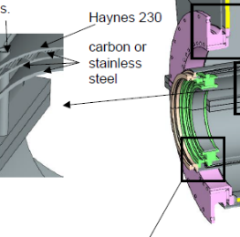
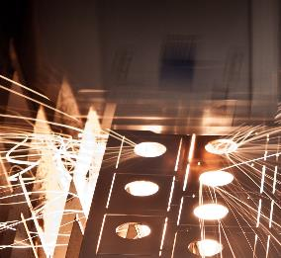
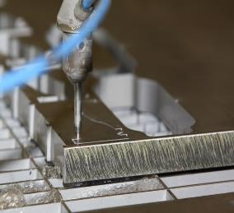
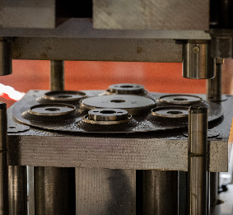
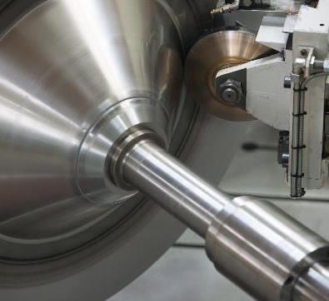

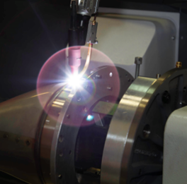
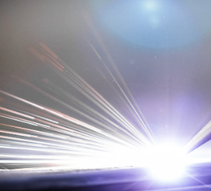
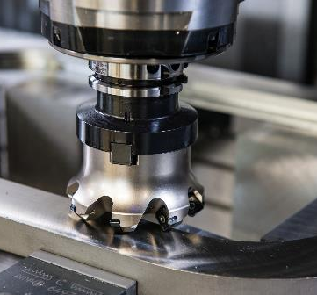
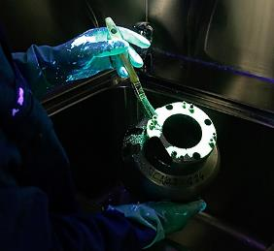
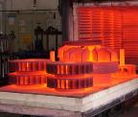
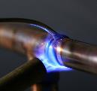
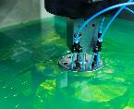
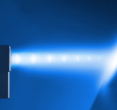
OUR PROCESSES
YOUR ADVANTAGE
Design for Manufacturing
Laser cutting
Water-Jet cutting
Deep drawing
Metal spinning
Welding
Laser drilling
Machining
FPI X-ray CMM
Qualified sub-supplier

Slide 4

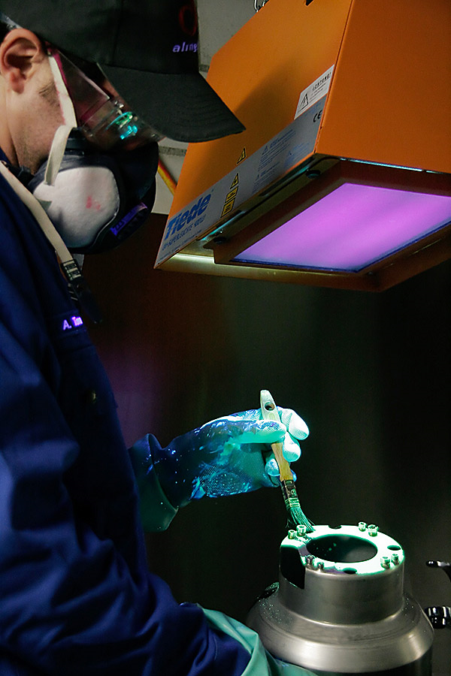
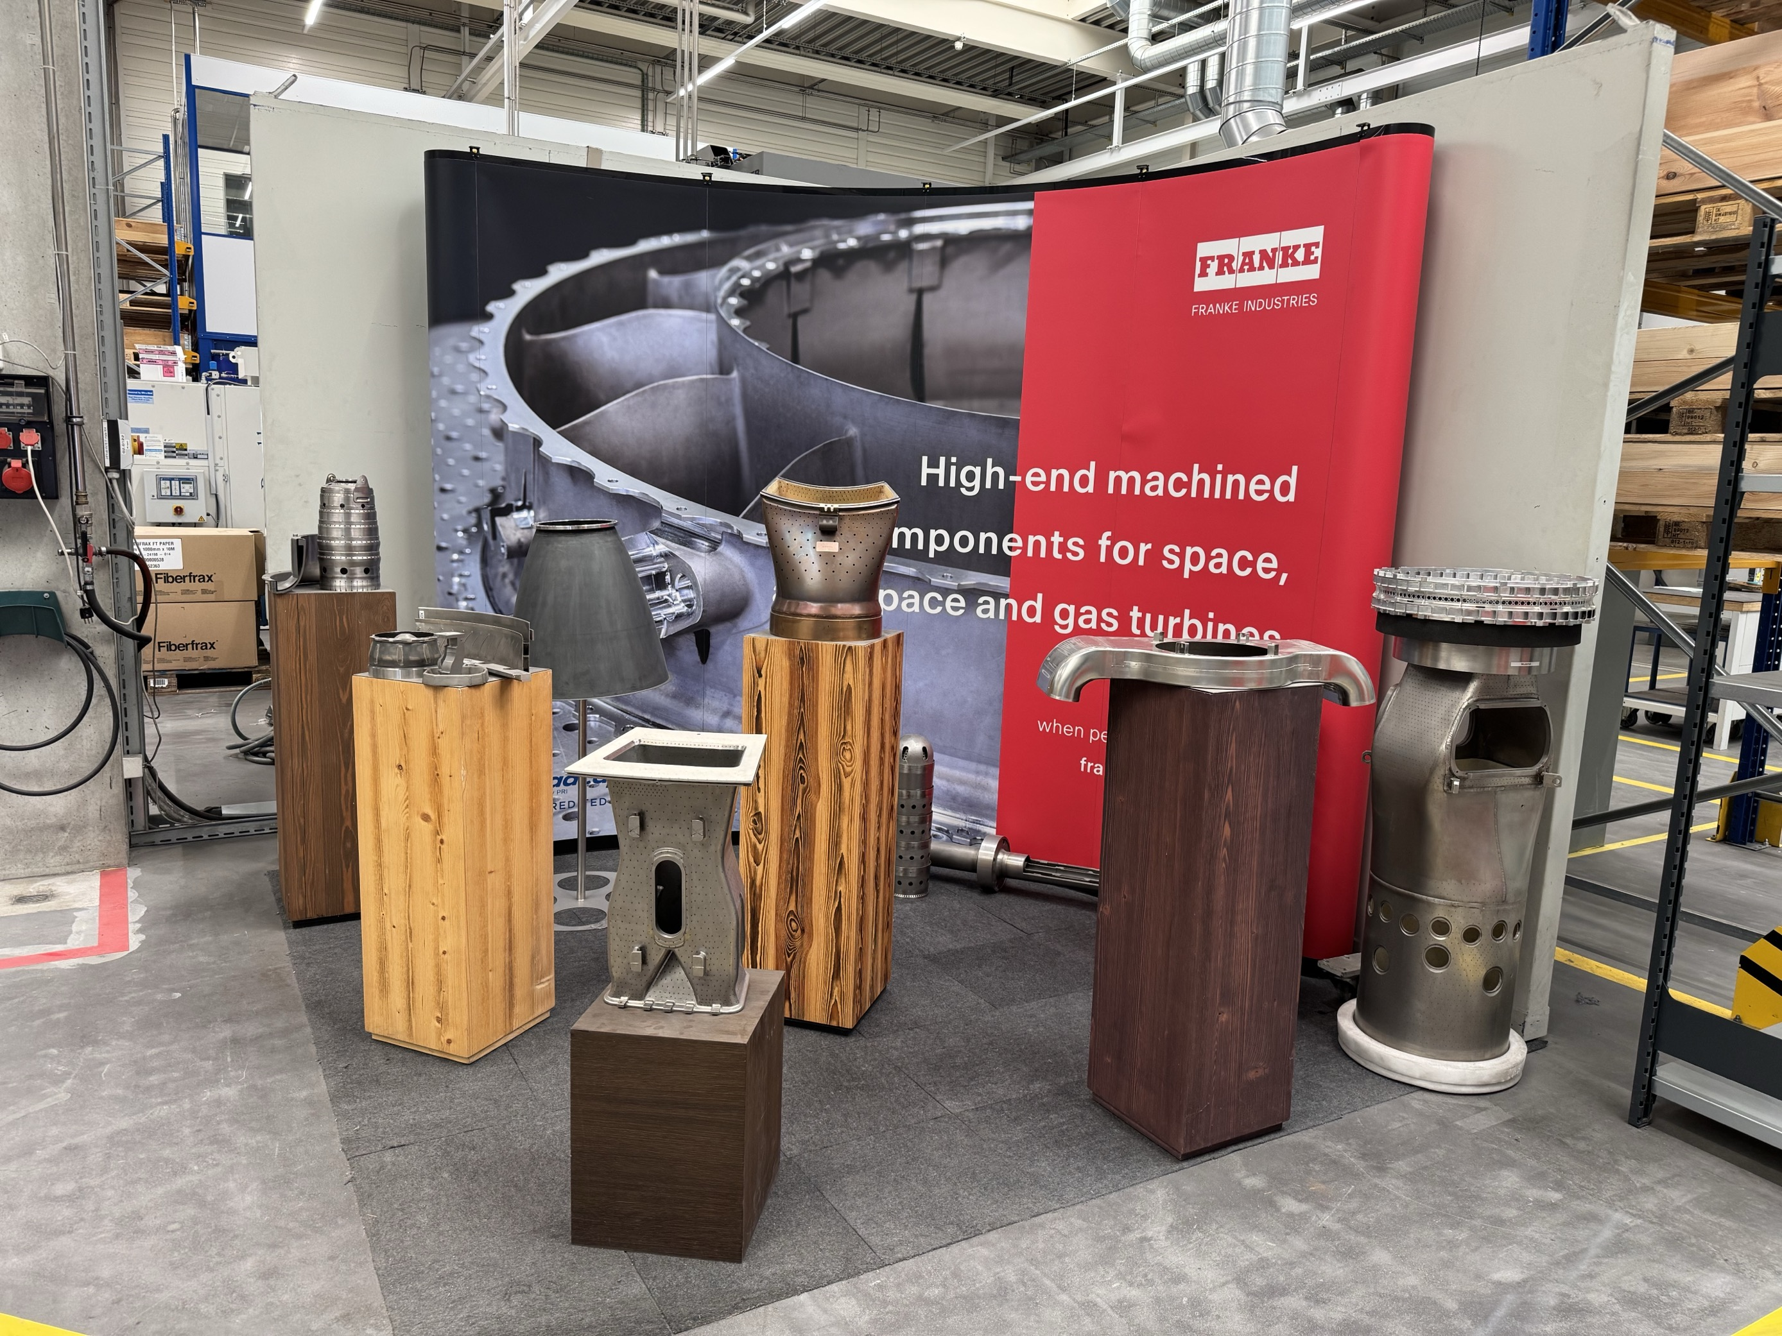
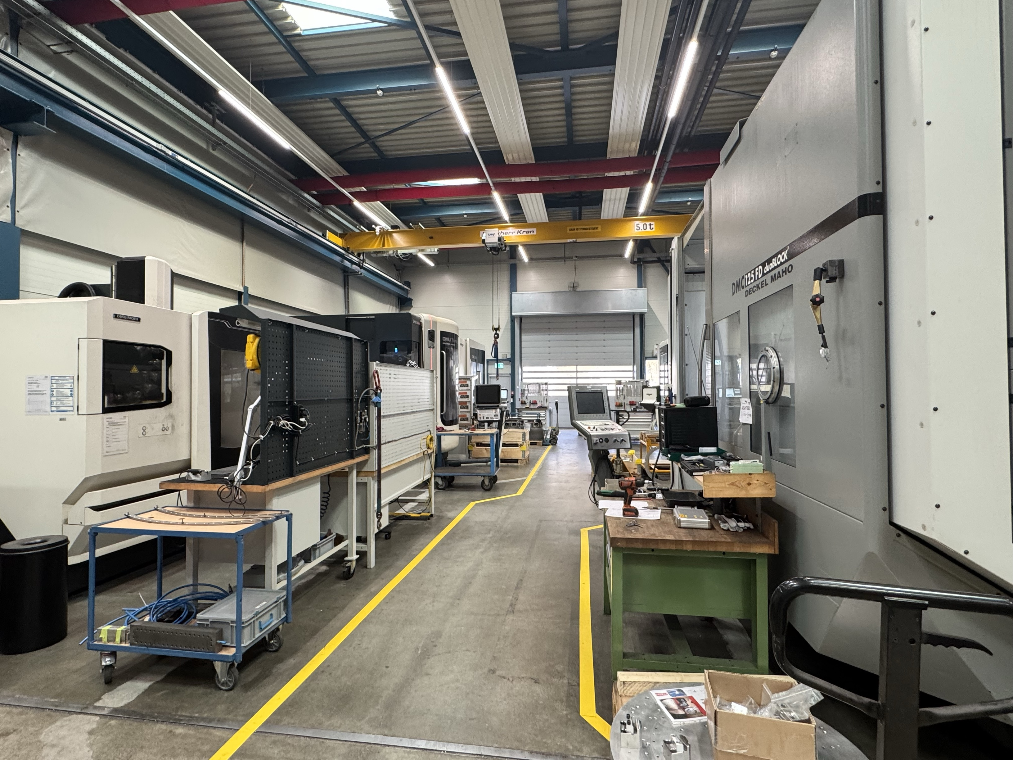
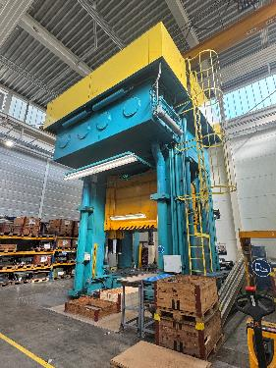
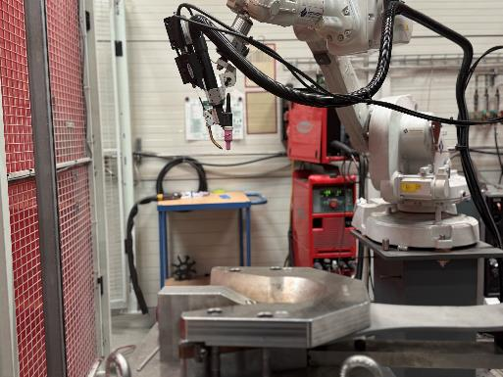
IMPRESSIONS PRODUCTION
WHEN PERFORMANCE MATTERS
Notes:
Bild Oben Links:
Neue Halle
Blick in Richtung Osten
Bild Oben Mitte:
Mitarbeiter NDT – Non Destructive Testing
beim FPI – Floureszence Penetrate Inspection
Bild Oben Rechts:
Produktionshalle
Show-Corner
Bild Unten Links:
Fräserei
Bild Unten Mitte:
2000 to. Presse
Bild Unten Rechts:
Schweissroboter

Slide 5

OUR STRENGTHS
WHEN PERFOMANCE MATTERS
Haynes
Hastelloy
Superalloys
Special manufacturing processes
Highest quality standards
Waspaloy
Inconel
Titanium
CMM
Water jet cutting
FPI
Metall spinning
X-ray
Laser drilling
NADCAP
Deep drawing
EN9100, AS13100
Welding

Slide 6
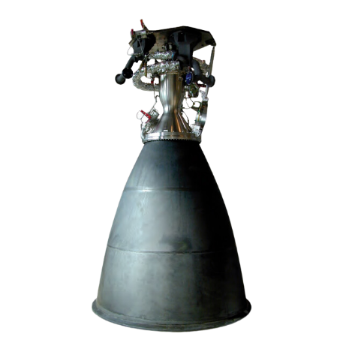
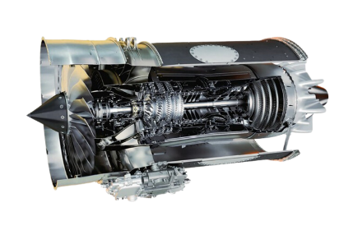
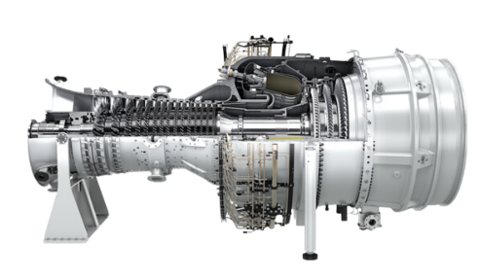
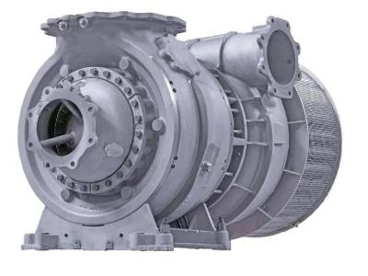
FRANKE INDUSTRIE AG
MARKET SEGMENTS
Aerospace
Hot-section parts for jet engines
Space
Complex Rocket components
Energy Sector
Hot Gas path parts
Industrial Applications
Parts and assemblies for advanced industries

Slide 7
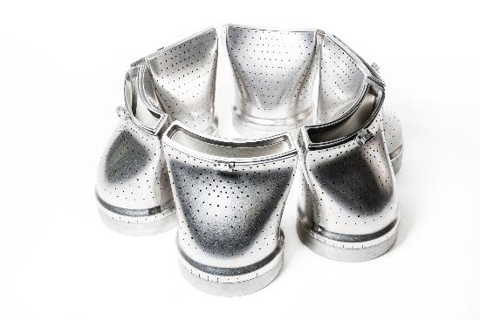
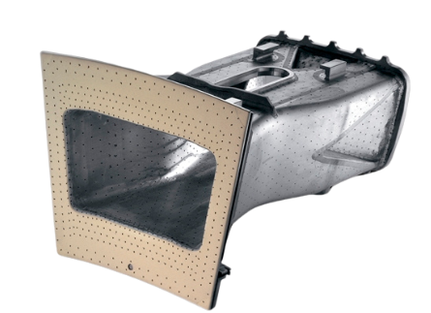
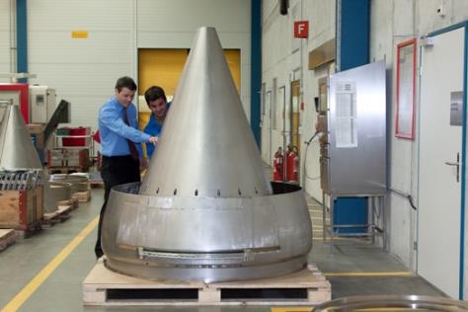
COMPONENTS
Gas Turbine Burner
Transition Pieces
Engine Exhaust Nozzle
Notes:
Bild Links:
Tie Shaft, Ø100x650mm
Rolls Royce
Bild Mitte:
PC12 – Pressure Dome
Pilatus
Bild Rechts:
SAFRAN Trent XWB – Tail Cone
Airbus A350

Slide 8
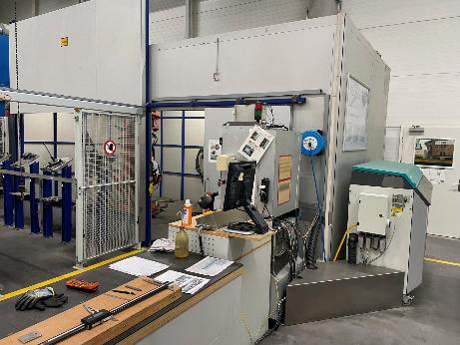
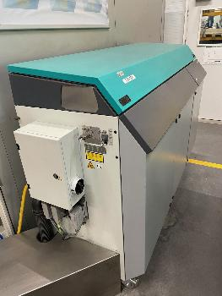
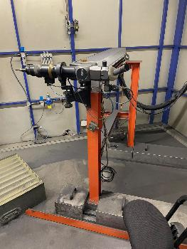
LASER DRILLING
Project Title: Replacement Laser Source for cutting and laser drilling
Project Manager: Bruno Roost
Description Business Case:
The 1st of our 3 laser drilling systems with lamp-pumped JAG lasers from Lasag AG was put into operation in 1997. The laser sources are reaching the end of their service life, spare parts are difficult to obtain, and a replacement of the systems is imperative.
Laser unit
Laser source
Laser head
Notes:
Bild Links:
Civil Aerospace – EOGV
Rolls Royce
Bild Mitte:
RB199 – Transformer Case
Tornado
Bild Rechts:
Eurojet EJ200 – Ölpump
Eurofighter Typhoon

Slide 9
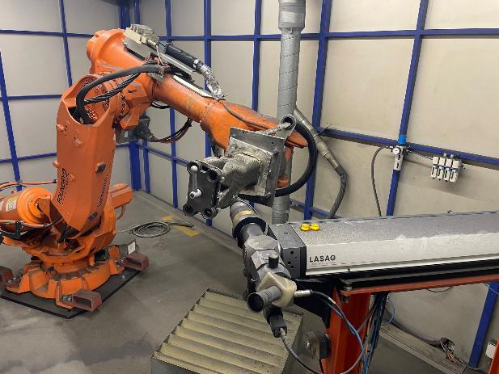
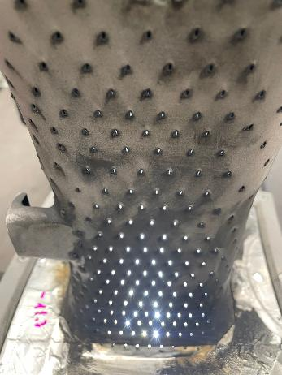
LASER DRILLING
Description Business Case (cont.):
The components are mounted onto the handling robot, the laser head in this set-up is fix. The handling robot moves the component in drilling position for each of the 2056 cooling holes of a Burner.
Set-up of a Burner
Visual inspection
Notes:
Bild Links:
Civil Aerospace – EOGV
Rolls Royce
Bild Mitte:
RB199 – Transformer Case
Tornado
Bild Rechts:
Eurojet EJ200 – Ölpump
Eurofighter Typhoon

Slide 10
LASER DRILLING
Description Business Case (cont.):
The handling robots and the surrounding processing cells respectively the machine equipment can continue to be used. New, energy-efficient pulsed fiber lasers with very high pulse powers (over 10 kW pulse power) have been available on the market for a few years.
In addition to the introduction of the new laser technology, the process characteristics are to be developed, optimized and validated to meet the increased demands of the market and to increase the company's competitiveness.
We receive technical support for the conversion of the systems from the FHNW in Brugg-Windisch and it includes the solution of the complex interfaces between the various technologies:
Laser engineering, installation and adjustment
Optical design and construction
Design, construction and manufacture of industrial-grade opto-mechanical systems
Integration of lasers and interfaces (control, water, electrical components)
Laser process development (laser drilling, cutting, welding)
Metallographic analysis and evaluation
Notes:
Bild Links:
Civil Aerospace – EOGV
Rolls Royce
Bild Mitte:
RB199 – Transformer Case
Tornado
Bild Rechts:
Eurojet EJ200 – Ölpump
Eurofighter Typhoon

Slide 11
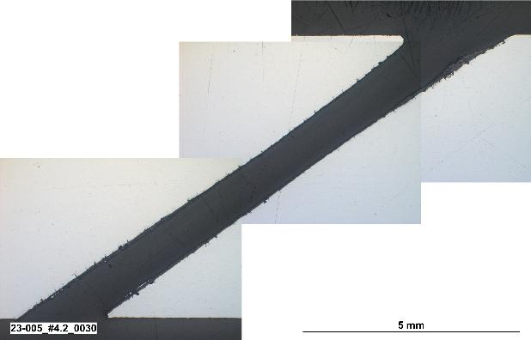
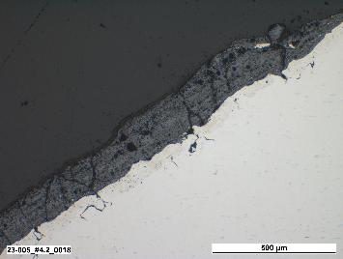
LASER DRILLING
Benefits:
Market security and maintaining competitiveness
Power savings > 90%
Improvement in drilling quality, covering increased customer requirements
Staged renewal of the systems possible
Notes:
Bild Links:
Civil Aerospace – EOGV
Rolls Royce
Bild Mitte:
RB199 – Transformer Case
Tornado
Bild Rechts:
Eurojet EJ200 – Ölpump
Eurofighter Typhoon

Slide 12

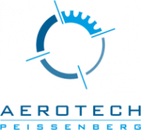
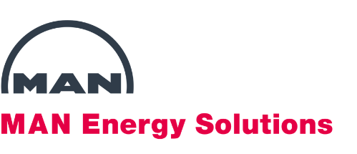

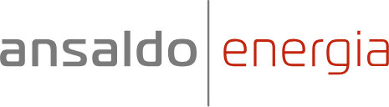










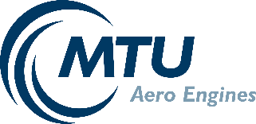




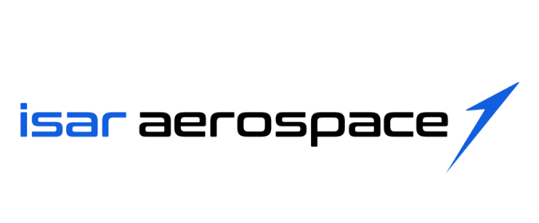


Customers

Slide 13

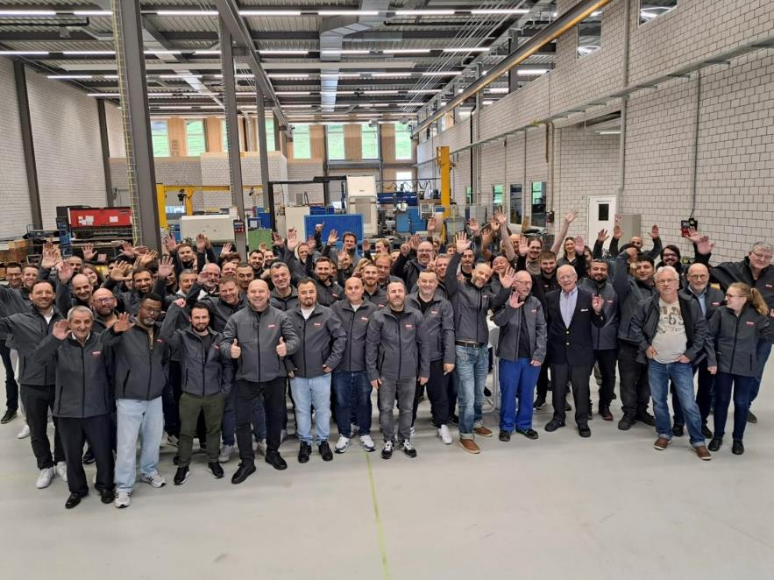
FRANKE INDUSTRIE AG 2025
WHEN PERFORMANCE MATTERS

Slide 14
Franke Industrie AG
Franke-Strasse 2
4663 Aarburg
Switzerland
when performance matters
Bruno Roost
Senior Engineer
Phone: +41 62 787 38 22
Mobile: +41 79 550 37 24
bruno.roost@franke.com
www.frankeindustries.com

